Slide 1
Product Review Analyzer Using ML
Mentor Name :- Student Name :-
Dr. Neeraj Kumar Pandey Shivang Mahendra
Univ. Roll No :-2019103

Slide 2
Introduction
We have to create a Product Review Analyzer that will analyze the reviews provided by user of the products used by them and classify them as positive or negative depending on the user’s review.
In this project, I have created a WebApp using html, CSS, bootstrap CSS for frontend and flask python framework for backend.
In frontend we take review as input from user or owner and in the backend using machine learning Long Short Term Memory (LSTM) algorithm we analyze the input and provide the results as positive or negative on the WebApp.
In backend, we preprocess the input which we receive from frontend and then pass it to our model which is based on LSTM then process it and give the output back to the WebApp and show it to the user.

Slide 3
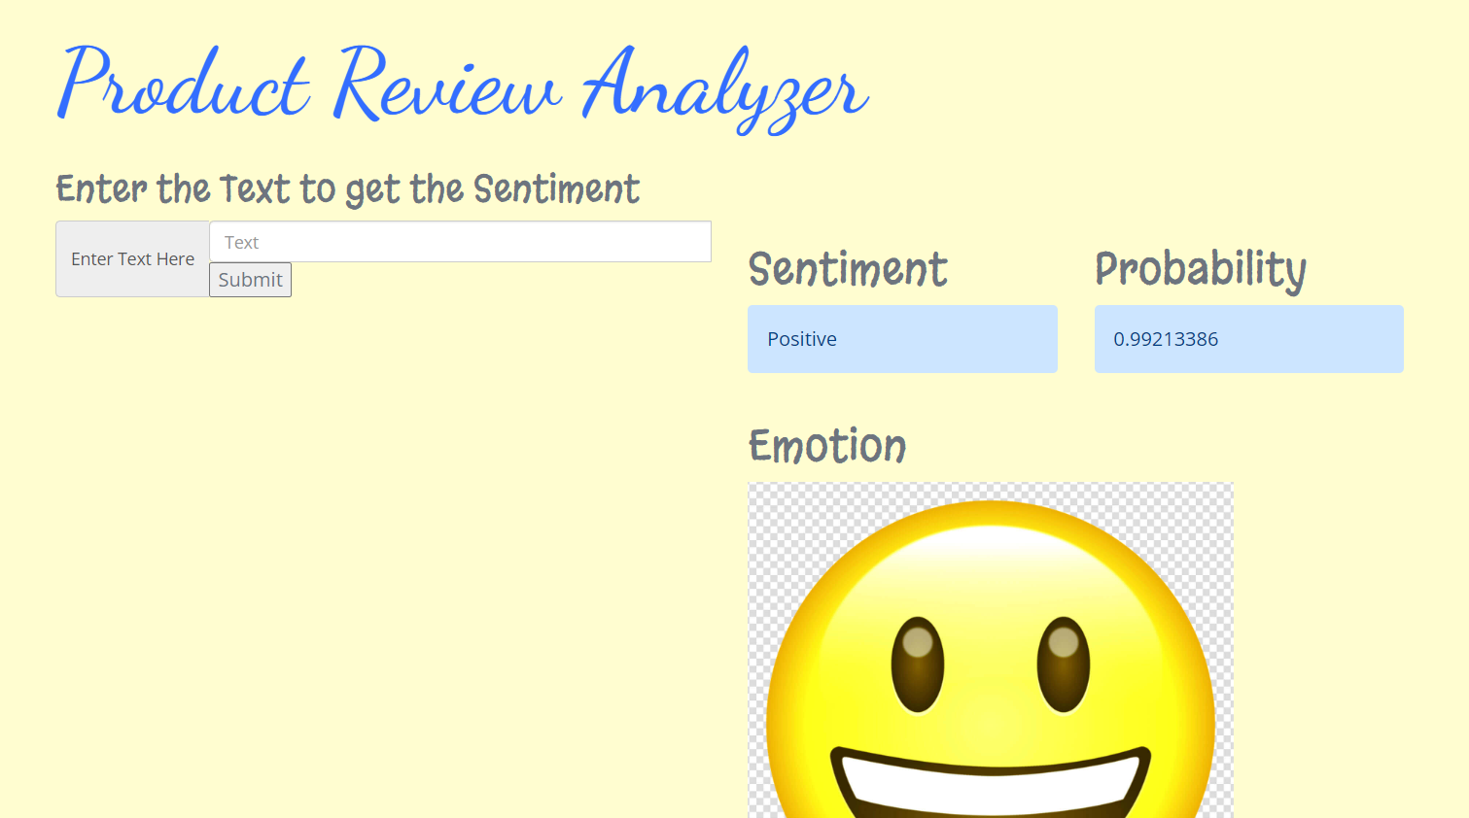
This is very useful for product owners as they can insert large number of reviews and get the analysis of whether their product is being liked by the public or not and what further improvements are needed to be done. This will help owners to provide better products and services to customers and earn more.

Slide 4
Methodology
Front-End :- For Front-End of Product Review Analyzer, I have used HTML, CSS and bootstrap framework CSS. In this front end we take review from user and pass it to backend which processes it and gives back the sentiment classification to front end and user can view it.
Back-End :- For Back-End of this Project on Product Review Analyzer, I have python framework Flask. Back-End passes the input to the LSTM model and gets the output from it i.e. sentiment class (positive or negative).

Slide 5
LSTM Model
The input is passed to the trained LSTM model which preprocesses the input and passes it the model and returns the class. The model is trained on the imdb dataset using 1 embedding vector layer, then 1 LSTM layer and 1 dense layer (which gives the predicted classes) and 2 dropout layers in between to prevent over-fitting and under-fitting of the data in layers. This model gives us a high accuracy of 86.5%.

Slide 6
Result and Discussion
The above shown methodology uses the LSTM model and it gives us a high frequency of 86.5% which is much higher than other machine learning and deep learning models used in which the accuracy ranges from 60-75%.

Slide 7
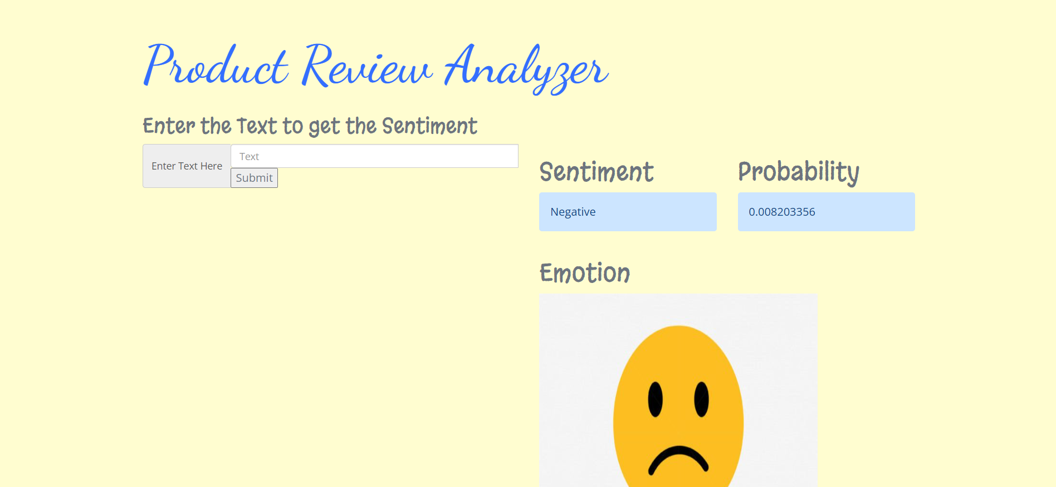

Slide 8
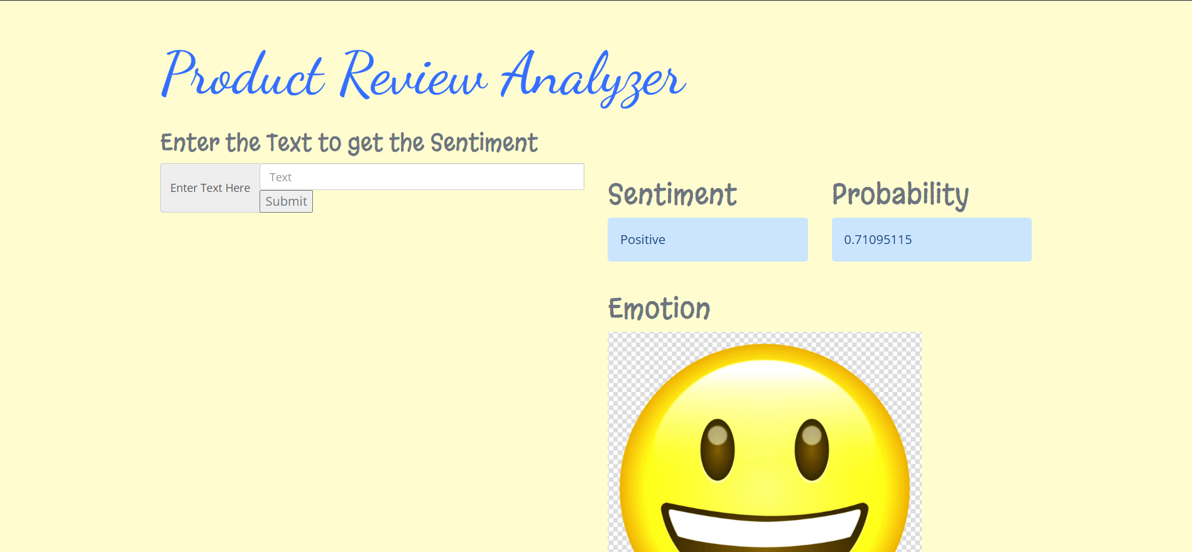

Slide 9
Conclusion and Future Work
Conclusion :- With the help of above-mentioned methodology, we have successfully completed the task of creating a Product Review Analyzer System and a WebApp for easy access for users with a high accuracy of 86.5%.
Future Work :- Better Quality and large Dataset: Better quality and large datasets will help in the training of LSTM model and give better frequency.

Slide 10
Handling Sarcasm and Irony: Detecting sarcasm in reviews is difficult due to the tone of context and is often missed by automated systems.
Real-Time Analysis: Processing of large amounts of revies in real-time will require better infrastructure, powerful servers, efficient algorithms and high preprocessing of data on which the WebApp is deployed.
Multilingual Sentiment Analysis: Making the sentiment analysis to accept and process reviews in different local languages.

Slide 11


